Slide 1

Megaminx
MMR 2020 – Group 3

Slide 2
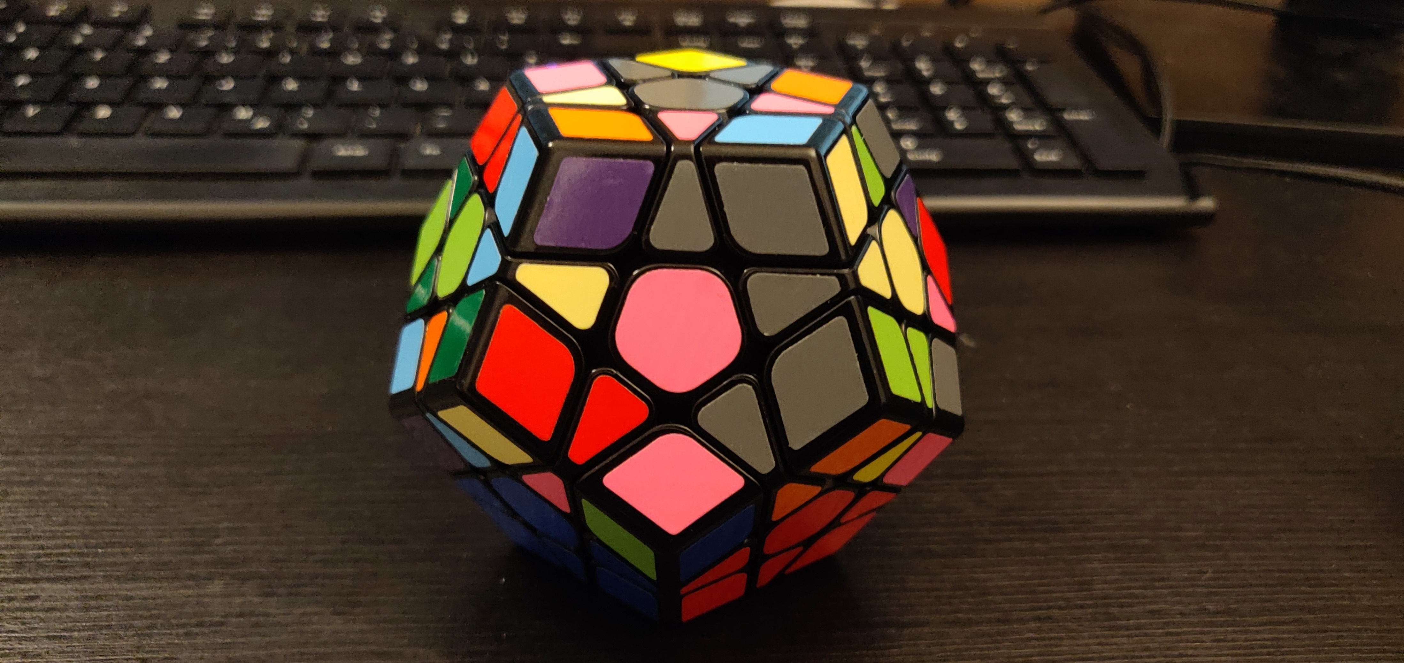
Goals
Reminder: Goal 32

Slide 3
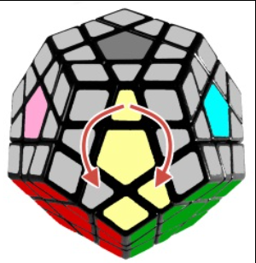
ALGORITHMS
SP3
SP4
F‘ R‘ F‘ F‘ R F
F L F F L‘ F‘

Slide 5
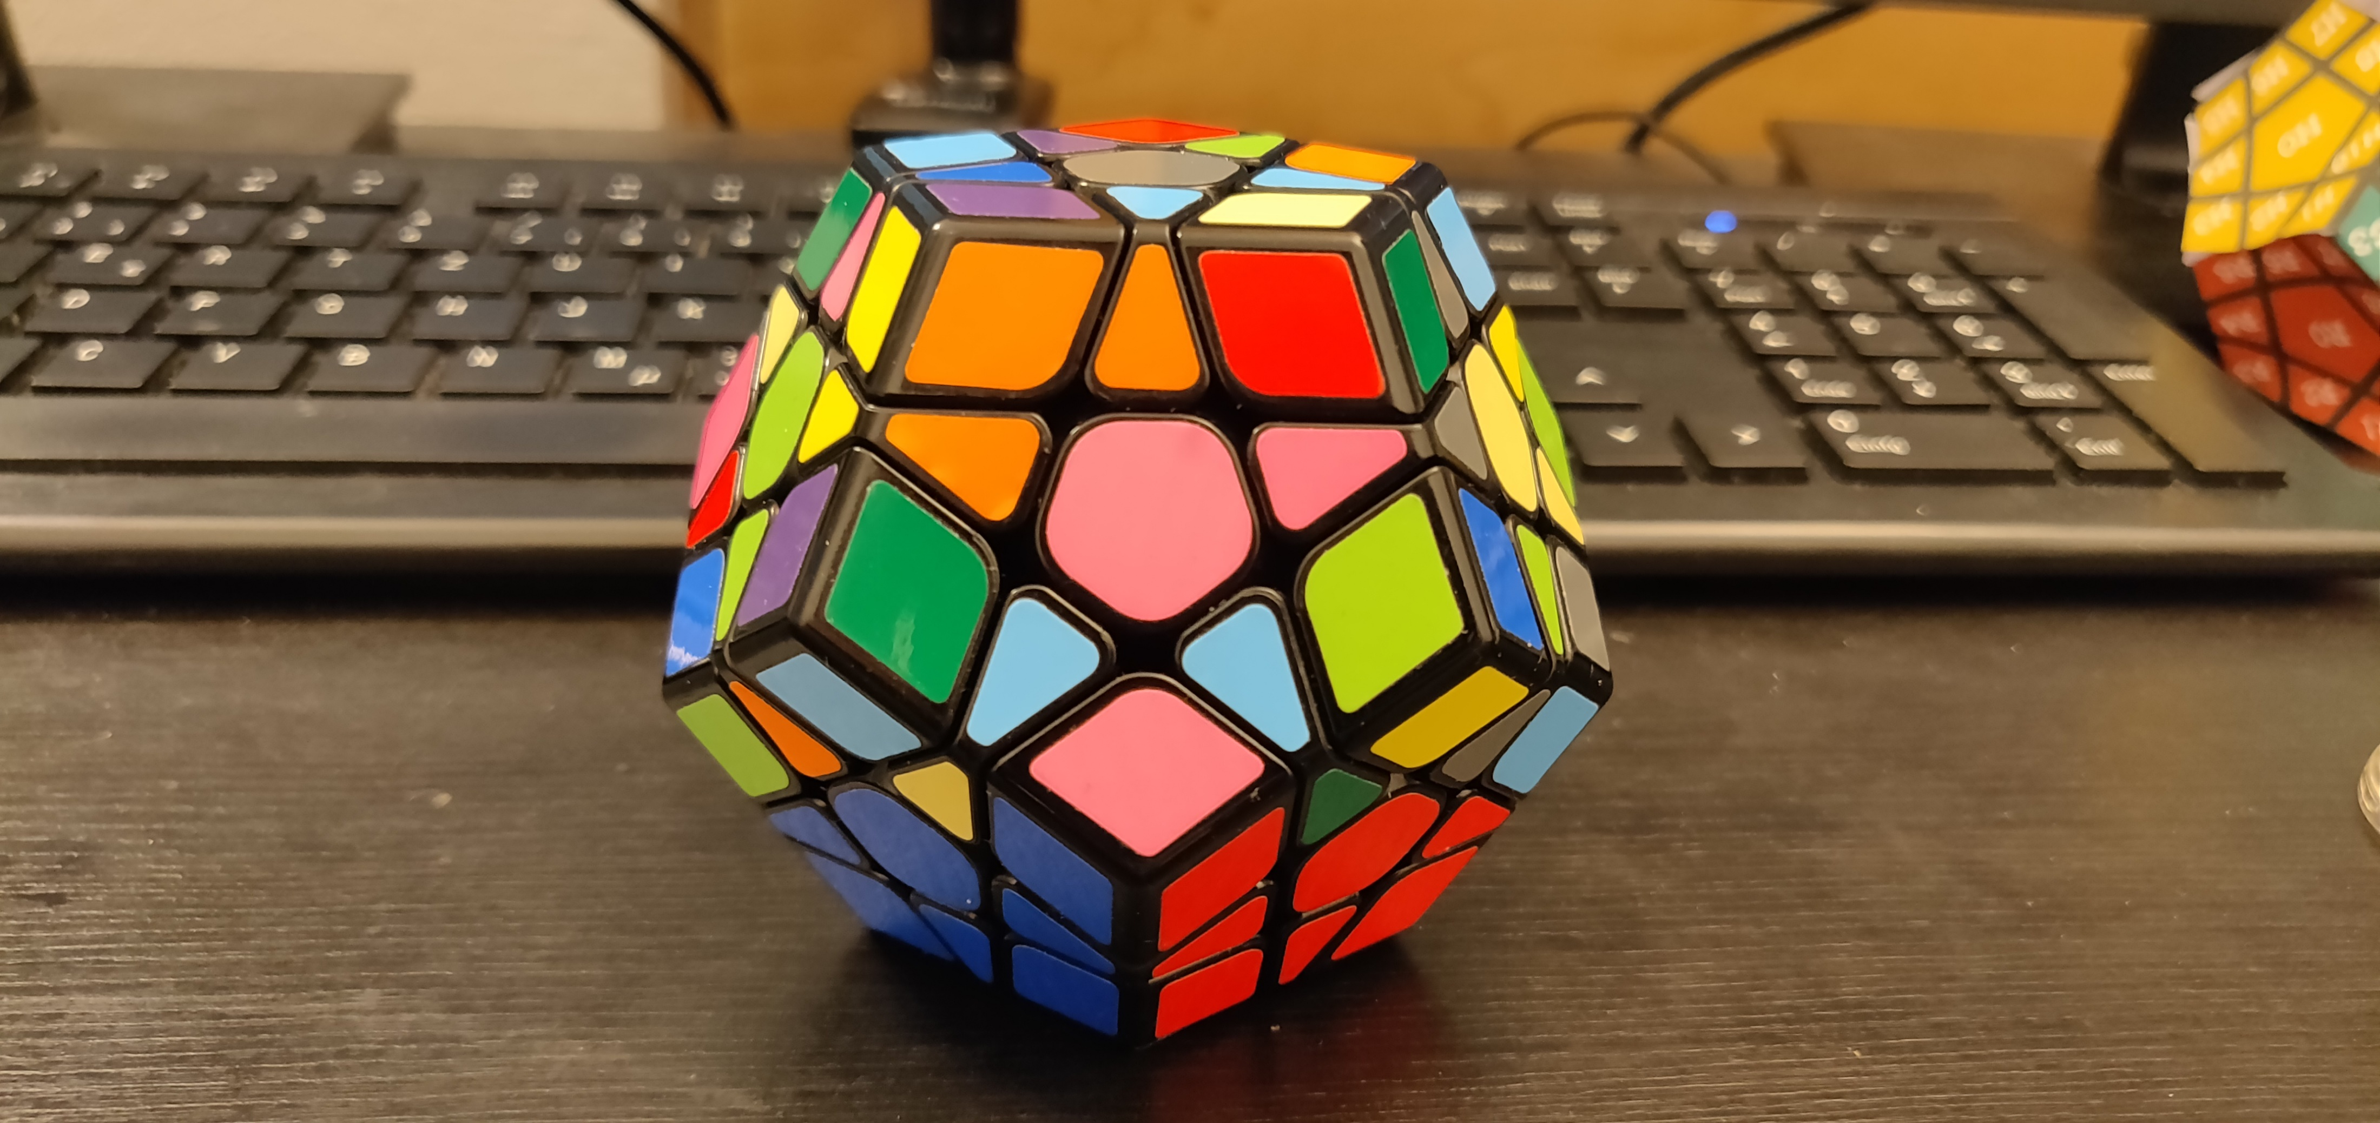
Goals
Goal 33
Moves: r, u, f, l, r_v

Slide 6
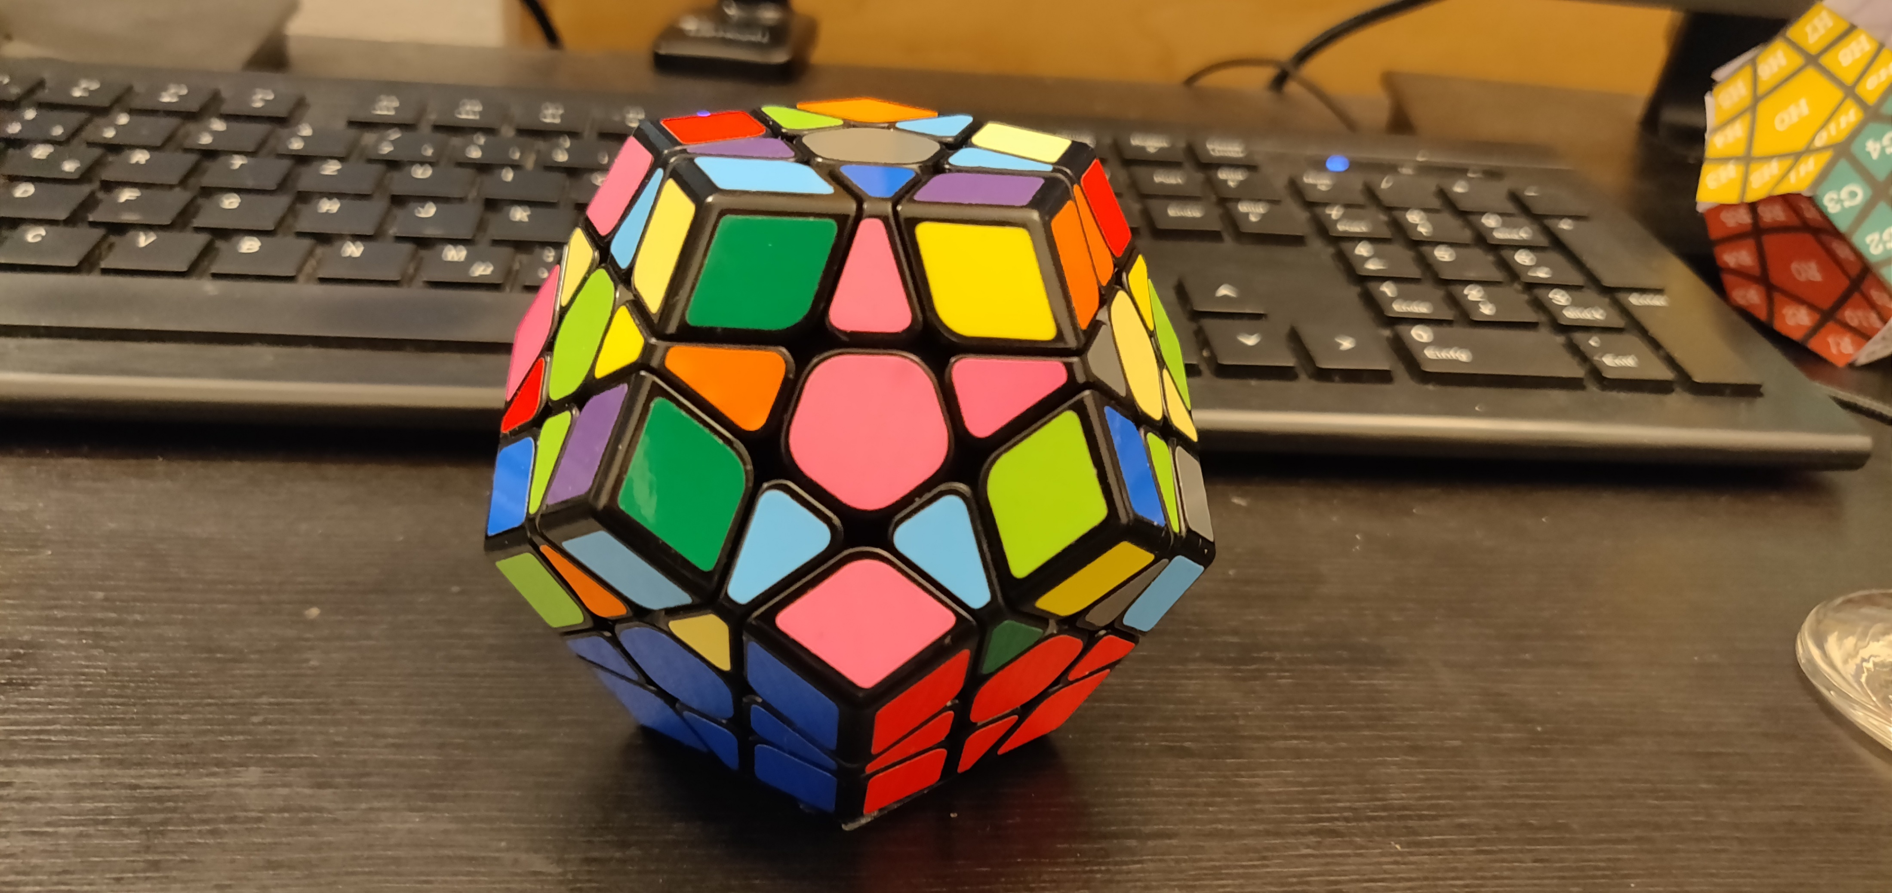
Goals
Goal 34
Moves: r, u, f, l, r_v

Slide 7
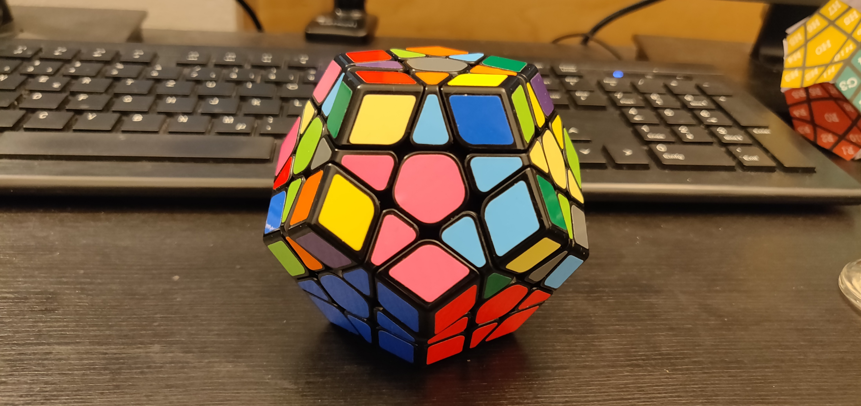
Goals
Goal 35
Moves: SP3

Slide 8
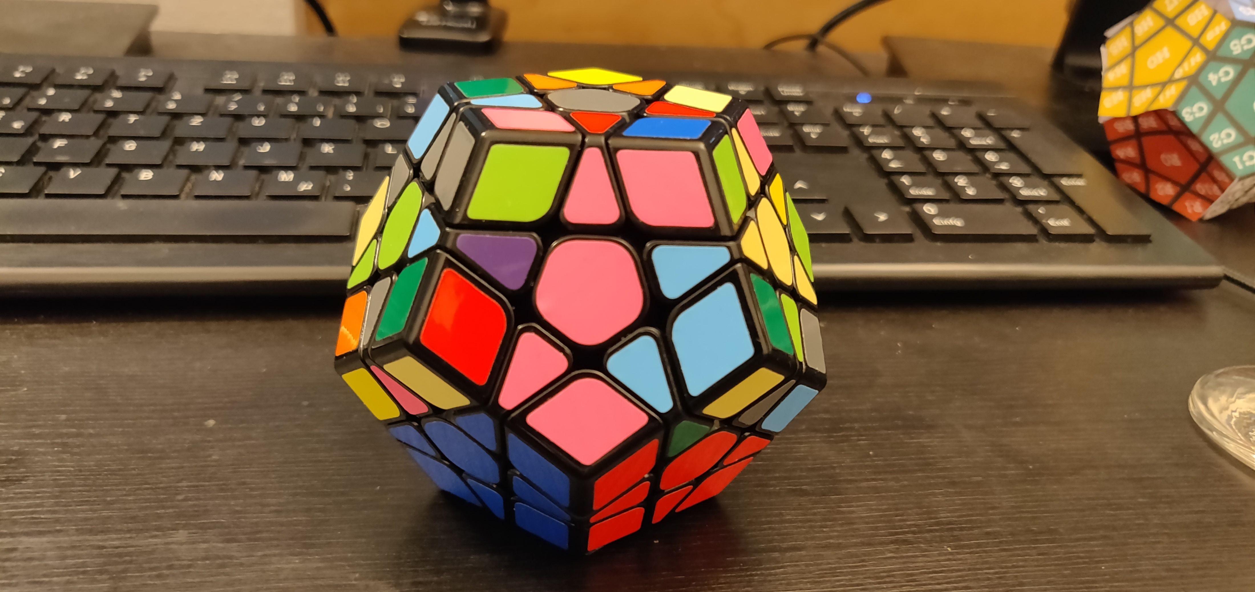
Goals
Goal 36
Moves: r, u, f, l, r_v

Slide 9
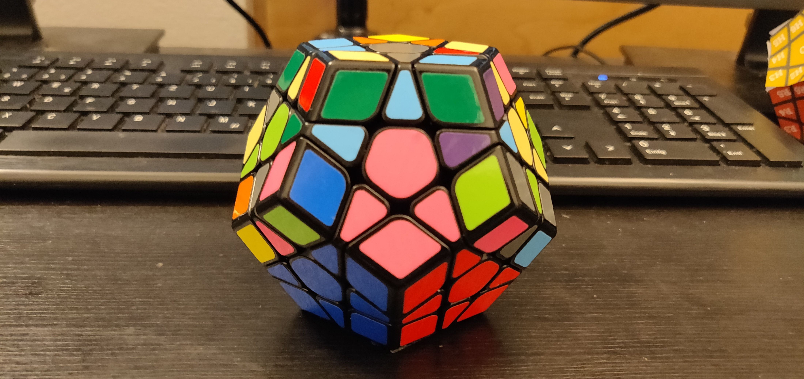
Goals
Goal 37
Moves: SP4

Slide 10
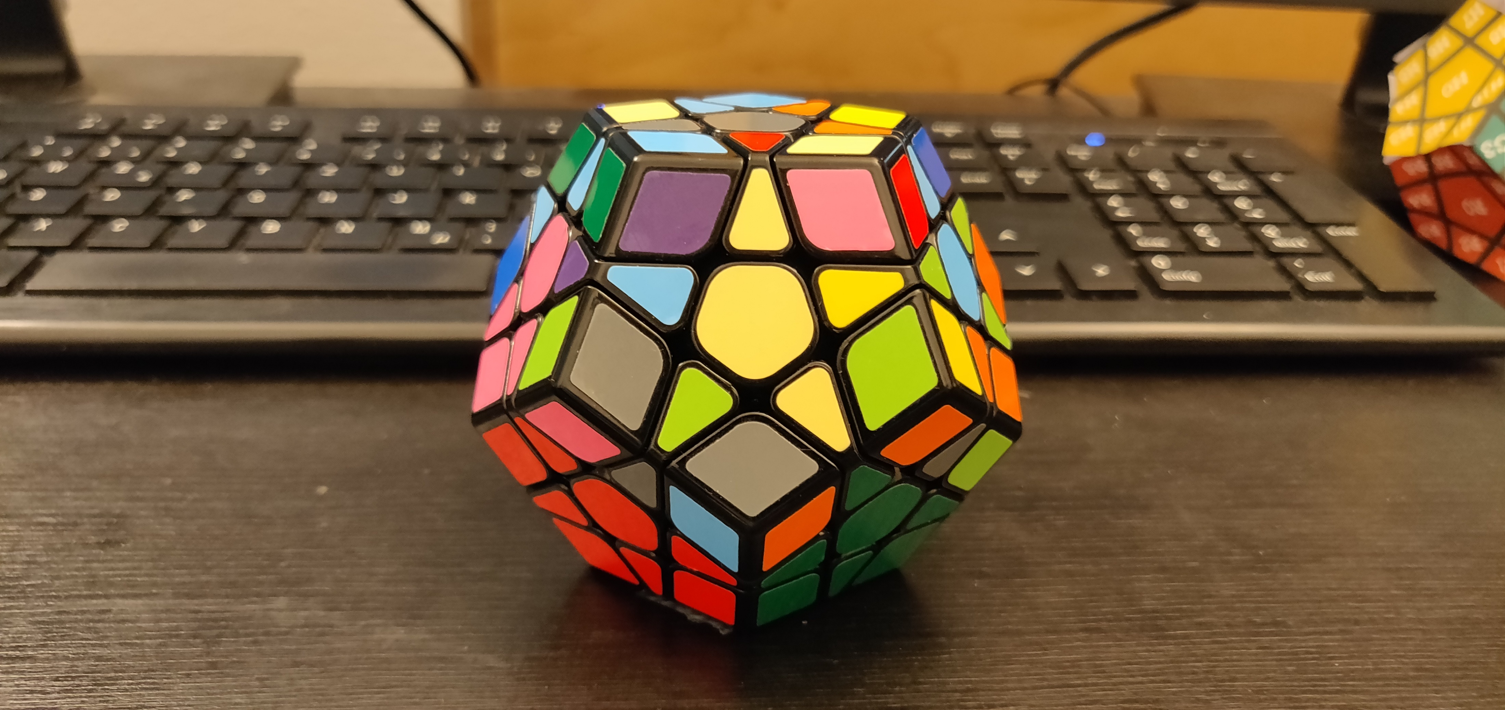
Goals
Goal 38
Moves: r_v

Slide 11
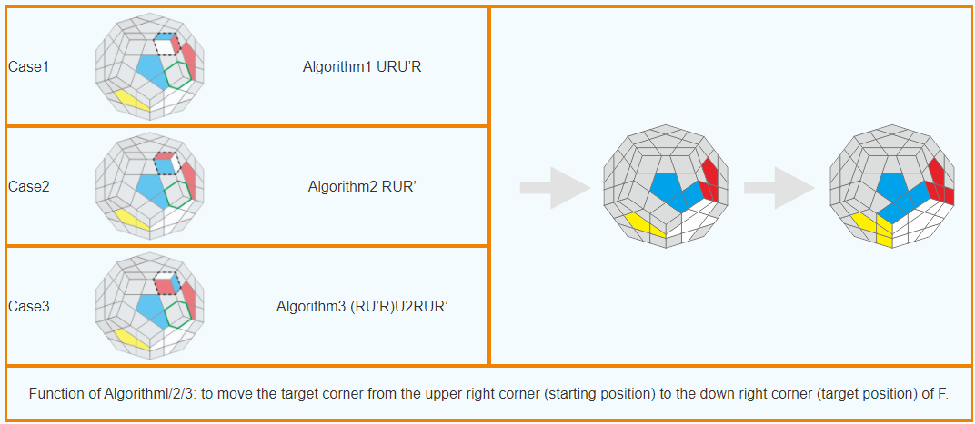
ALGORITHMS
SP5
SP6
SP7
U R U‘ R‘
R U R‘
(R U‘ R‘) U U R U R‘

Slide 12
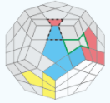
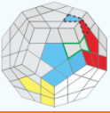
ALGORITHMS
SP8
SP9
(U R U‘ R‘ U‘) (F‘ U F)
(R‘ F‘ R U)(R U‘ R‘ F)

Slide 13
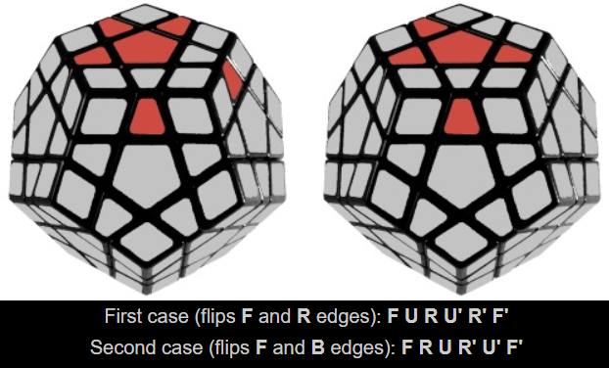
ALGORITHMS
SP11
SP12

Slide 14
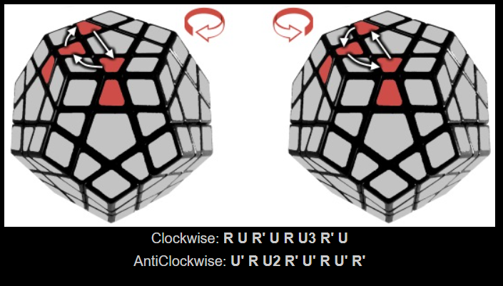
ALGORITHMS
SP13
SP14

Slide 15
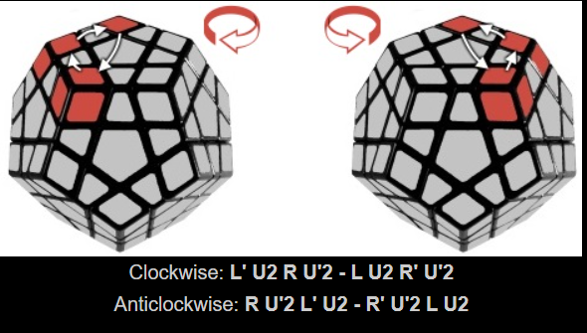
ALGORITHMS
SP15
SP16

Slide 16
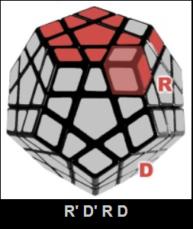
SP17

Slide 17
ALGORITHMS
BACKUP
SP6
R U R‘

Slide 18
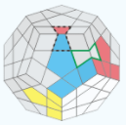
ALGORITHMS
BACKUP
SP7
(URU‘R‘U‘)(F‘UF)

Slide 19
ALGORITHMS
BACKUP
SP5
SP6
SP7
U R U‘ R‘
R U R‘
(R U‘ R‘) U U R U R‘

